Slide 1
DBMS
Food Topia

Slide 2
AGENDA
Data set collection and tools setups
Implementation flow chart
Git-hub commits
Work progress.

Slide 3
Introduction
An Online Food Ordering System is proposed here which simplifies the food ordering process.
The proposed system shows an user interface and update the menu with all
available options so that it eases the customer work.
Customer can choose more than one item to make an order and can view
order details before logging off.
The order confirmation is sent to the customer.
The order is placed in the queue and updated in the database and returned in real time.
This system assists the staff to go through the orders in real time and process it efficiently with minimal errors.

Slide 4
Data Set collection And tools required

Slide 5
A data structure is a specialized format for organizing, processing, retrieving and storing data.
There are several basic and advanced types of data structures, all designed to arrange data to suit a specific purpose.
We will be mainly Focusing on three main methods
Strings.
Recurssions.
Files
TOOLS:
MYSQL, TerraER, Django, HTML

Slide 6
Implementation
Flow chart

Slide 7
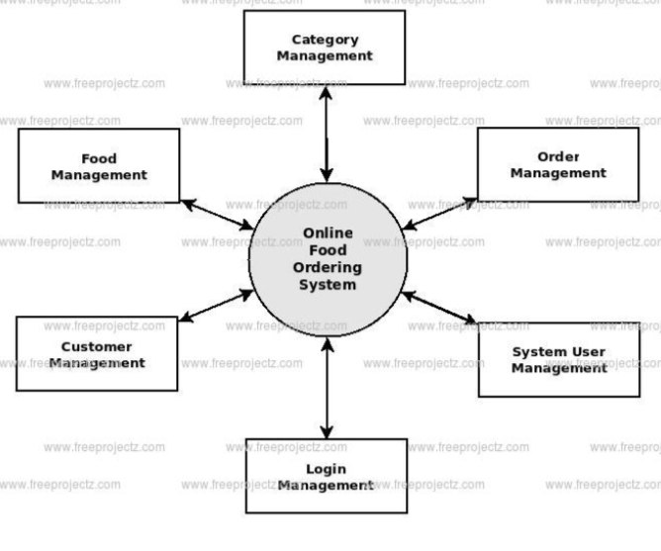

Slide 8
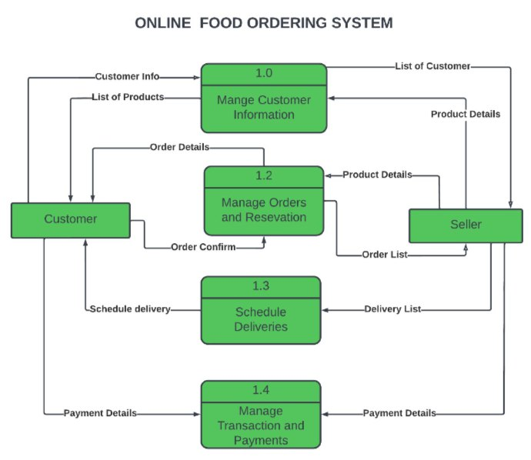

Slide 9
Git-hub Commits

Slide 10
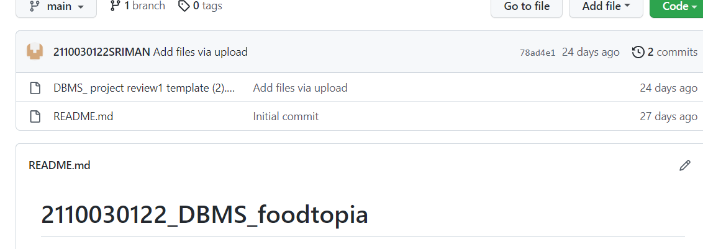

Slide 11
Work progress

Slide 12
Started to work on basic front end page.
Working on the required things that needed to be done.
Working on the entities required to allow the sequence of the flow of the contents.
Working on the 0th level and 1st level flow charts.

Slide 13
THANK YOU
2110030326-CH Chaitanya Madhav
2110030122-K Sriman Narayana
2110030223-Dandu Poojitha
2110030339-A Lakshmi Narayana

